Slide 1
FAKE NEWS DETECTION

Slide 2
Introduction
Paskin defines fake news as “particular news articles that originate either on mainstream media (online or offline) or social media and have no factual basis, but are presented as facts and not satire”. The importance of combatting fake news is starkly illustrated during the current COVID-19 pandemic.

Slide 3
Literature Survey And dataset
Sr. No | Title of Paper/Article and Authors names | URL of the website from where it is downloaded
1. | Detecting Fake news Online | https://en.m.wikipedia.org/wiki/Detecting_fake_news_online
2. | Linguistic Based detection of Fake News in Social Media | https://ijel.ccsenet.org
3. | Approaches to Identify Fake News: A Systematic Literature Review | https://www.ncbi.nlm.nih.gov/pmc/articles/PMC7250114/

Slide 4
Literature Survey And dataset
Sr. No | Title of Paper/Article and Authors names | URL of the website from where it is downloaded
4. | Fake news detection using discourse segment structure analysis | https://ieeexplore.ieee.org/document/9058106/authors#authors
5 | Hindi dataset | https://github.com/mohit19014/Hindi-Hostility-Detection-CONSTRAINT-2021
6 | English dataset | https://www.kaggle.com/clmentbisaillon/fake-and-real-news-dataset

Slide 5
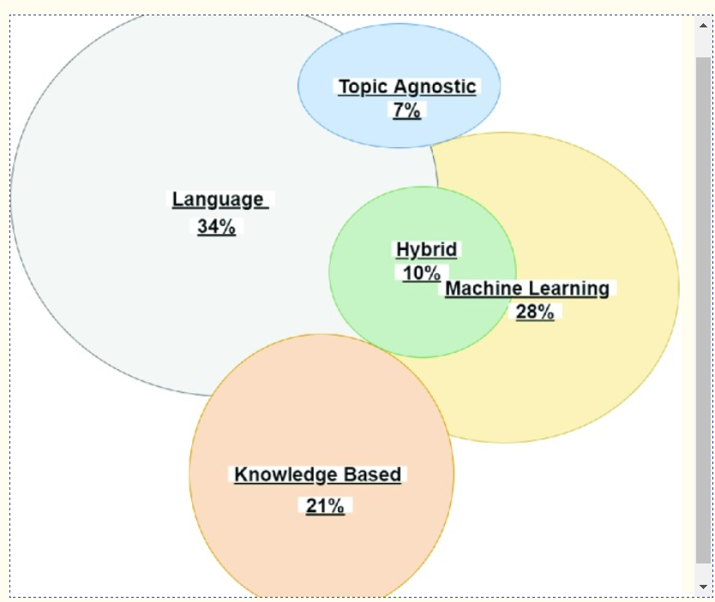

Slide 6
Language Approach
Bag of Words (BOW)
Semantic Analysis
Deep Syntax

Slide 7
Topic-Agnostic Approach
This category of approaches detect fake news by not considering the content of articles bur rather topic-agnostic features.

Slide 8
Machine Learning Approach
Machine learning algorithms can be used to identify fake news. This is achieved through using different types of training datasets to refine the algorithms. Datasets enables computer scientists to develop new machine learning approaches and techniques. Datasets are used to train the algorithms to identify fake news.
A machine learning approach called the rumor identification framework has been developed that legitimizes signals of ambiguous posts so that a person can easily identify fake news

Slide 9
Knowledge Based Approach
Expert Oriented Fact Checking.
Computational Oriented Fact Checking
Crowd Sourcing Oriented

Slide 10
Zero Shot Approach
So to overcome the data boundation here we use a zero shot method where the model is able to classify without any prior training. This is done via hypothesis testing where both text and hypothesis are compared.

Slide 11
Conclusion
Paper we discussed the prevalence of fake news and how technology has changed over the last years enabling us to develop tools that can be used in the fight against fake news. We also explored the importance of identifying fake news, the influence that misinformation can have on the public’s decision making and which approaches exist to combat fake news. The current battle against fake news on COVID-19 and the uncertainty surrounding it, shows that a hybrid approach towards fake news detection is needed. Human wisdom as well as digital tools need to be harnessed in this process.

Slide 12
Reference
Ahmed, S., Hinkelmann, K., Corradini, F.: Combining machine learning with knowledge engineering to detect fake news in social networks - a survey. In: Proceedings of the AAAI 2019 Spring Symposium, vol. 12 (2019)
Albright J. Welcome to the era of fake news. Media Commun. 2017;5(2):87. doi: 10.17645/mac.v5i2.977. [CrossRef] [Google Scholar]
Atodiresei C-S, Tănăselea A, Iftene A. Identifying fake news and fake users on twitter. Procedia Comput. Sci. 2018;126:451–461. doi: 10.1016/j.procs.2018.07.279. [CrossRef] [Google Scholar]
Burkhardt JM. History of fake news. Libr. Technol. Rep. 2017;53(8):37. [Google Scholar]
Castelo, S., Almeida, T., Elghafari, A., Santos, A., Pham, K., Nakamura, E., Freire, J.: A topic-agnostic approach for identifying fake news pages. In: Companion Proceedings of the 2019 World Wide Web Conference on - WWW 2019, pp. 975–980 (2019). 10.1145/3308560.3316739
Chen, Y., Conroy, N.J., Rubin, V.L.: Misleading online content: recognizing clickbait as false news? In: Proceedings of the 2015 ACM on Workshop on Multimodal Deception Detection - WMDD 2015, Seattle, Washington, USA, pp. 15–19. ACM Press (2015a). 10.1145/2823465.2823467
Chen Yimin, Conroy Nadia K., Rubin Victoria L. News in an online world: The need for an “automatic crap detector” Proceedings of the Association for Information Science and Technology. 2015;52(1):1–4. [Google Scholar]
Hassan, N., Arslan, F., Li, C., Tremayne, M.: Toward automated fact-checking: detecting check-worthy factual claims by claimbuster. In: Proceedings of the 23rd ACM SIGKDD International Conference on Knowledge Discovery and Data Mining - KDD 2017, Halifax, NS, Canada, pp. 1803–1812. ACM Press (2017). 10.1145/3097983.3098131
Horne, B.D., Adali, S.: This just in: fake news packs a lot in title, uses simpler, repetitive content in text body, more similar to satire than real news. In: International AAAI Conference on Web and Social Media, vol. 8 (2017)
Macaulay, T.: Can technology solve the fake news problem it helped create? (2018). https://www.techworld.com/startups/can-technology-solve-fake-news-problem-it-helped-create-3672139/

